Slide 1
FBI
development
To Visualize SALES (or Usage)
- Most have no usage
Commdity relation to Federal Assets (i.e Rice)
CHART
Yang Mirco services
Cisco motoring
CPU
CHART
CHART
CAR
nonPoliceTRX
CAR
nonPoliceTRX
CHART
DISK
CHART
CHART
nonPoliceTRX
nonPoliceTRX
MEMORY
CHART
CHART
nonPoliceTRX
nonPoliceTRX
12pm(lunch)

Slide 2
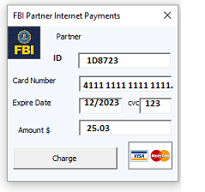
FBI
development
To Visualize SALES (or Usage)
- Most have no usage
Web Service
WSDL
AVAILBILITY.REST
Amazon
apple
Saby know Unix
White. oncall
bezos
https://ics2wsa.ic3.com/commerce/1.x/transactionProcessor/CyberSourceTransaction_1.207.wsdl
cook
CHART
CHART
12pm(lunch)
12pm(lunch)

